Slide 1
Week 1 Challenge
Yuri, Angel, Lucy, Sanjana

Slide 2
Table of Contents
Goals
Running Age and Sex as Explanation Sheet
Correlation (Heat) Map
Random Forest
Final ROC curve + confusion matrix

Slide 3
Goals
Find the least amount of features to obtain the most accuracy on classifying hypothyroidism
Find the best model for this dataset

Slide 4
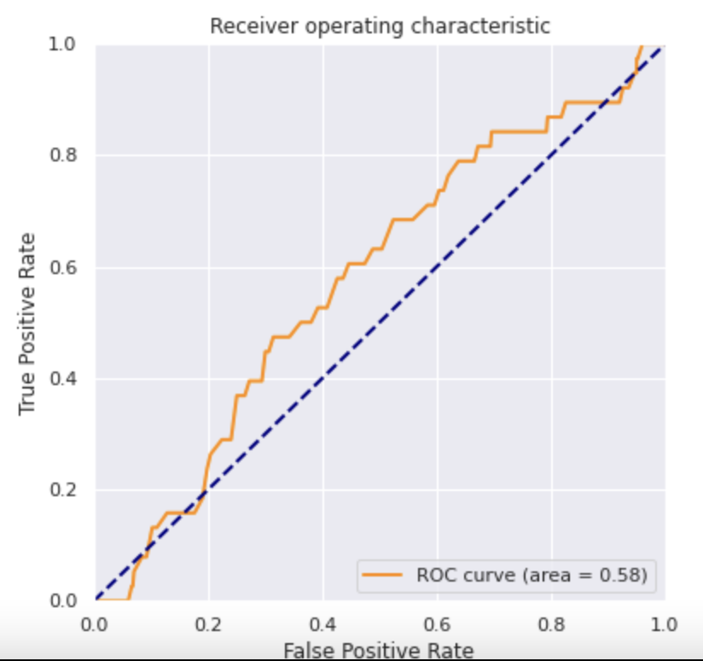
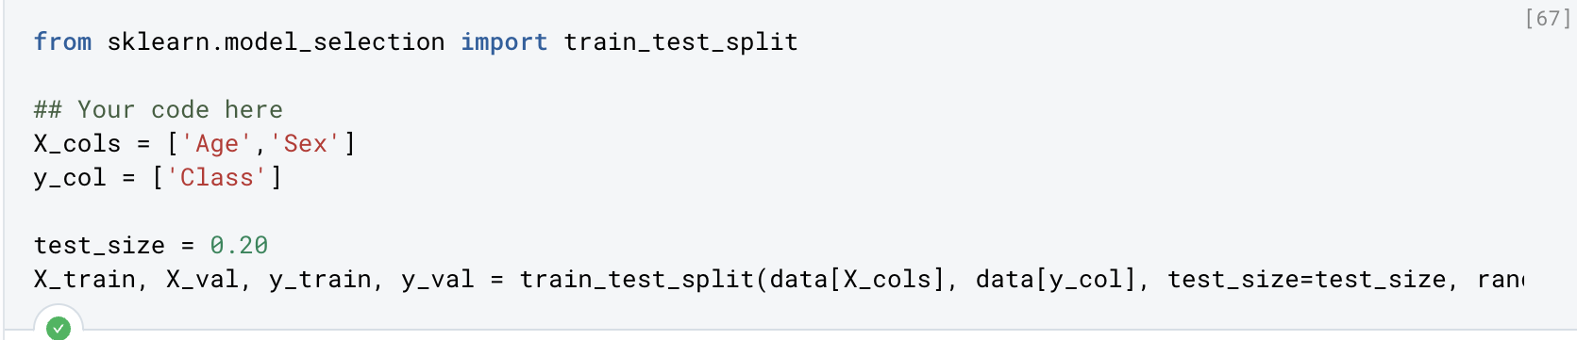
Age & Sex

Slide 5
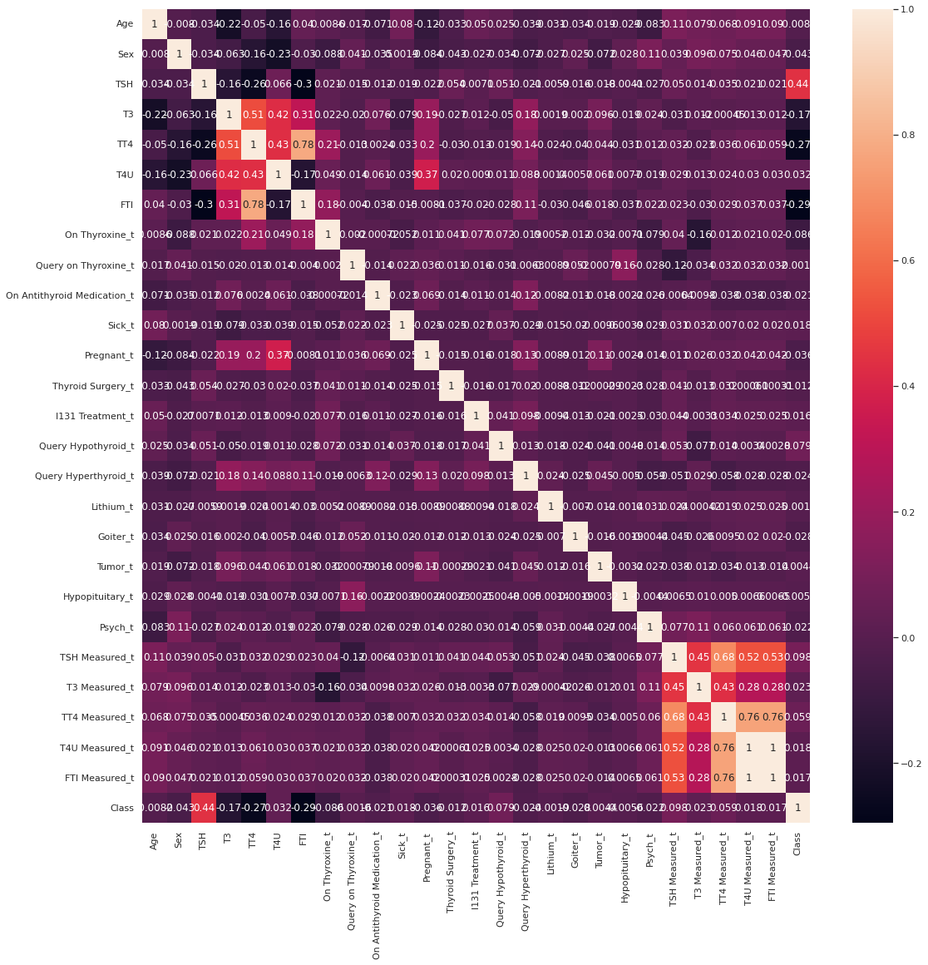
Heatmap of Correlation

Slide 6
Heatmap of Correlation

Slide 7
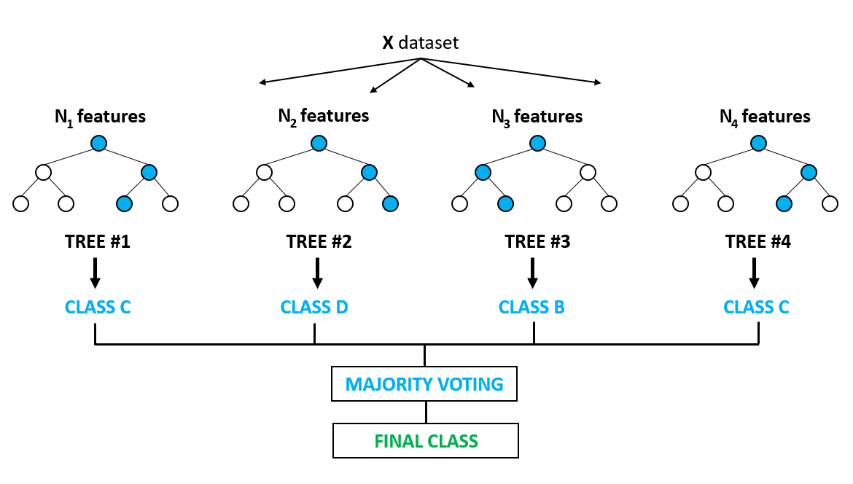
Feature Selection with Random Forest
Feature Selection Using Random forest | by Akash Dubey | Towards Data Science

Slide 8
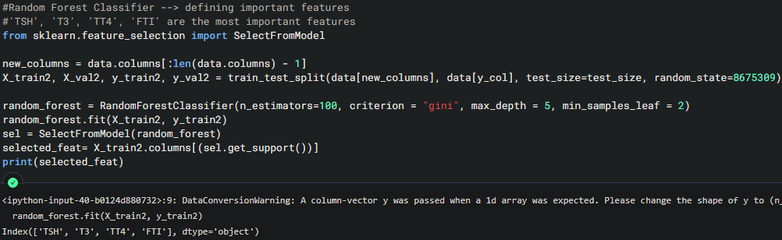
Feature Selection with Random Forest

Slide 9
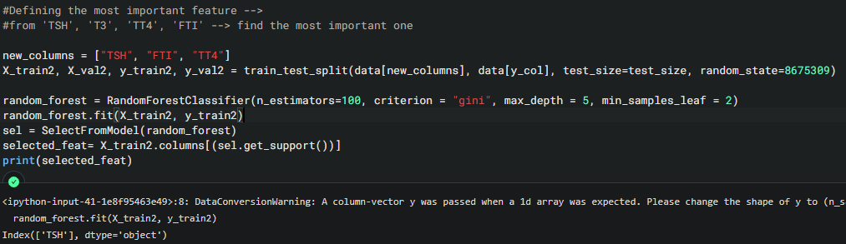
Feature Selection with Random Forest

Slide 10
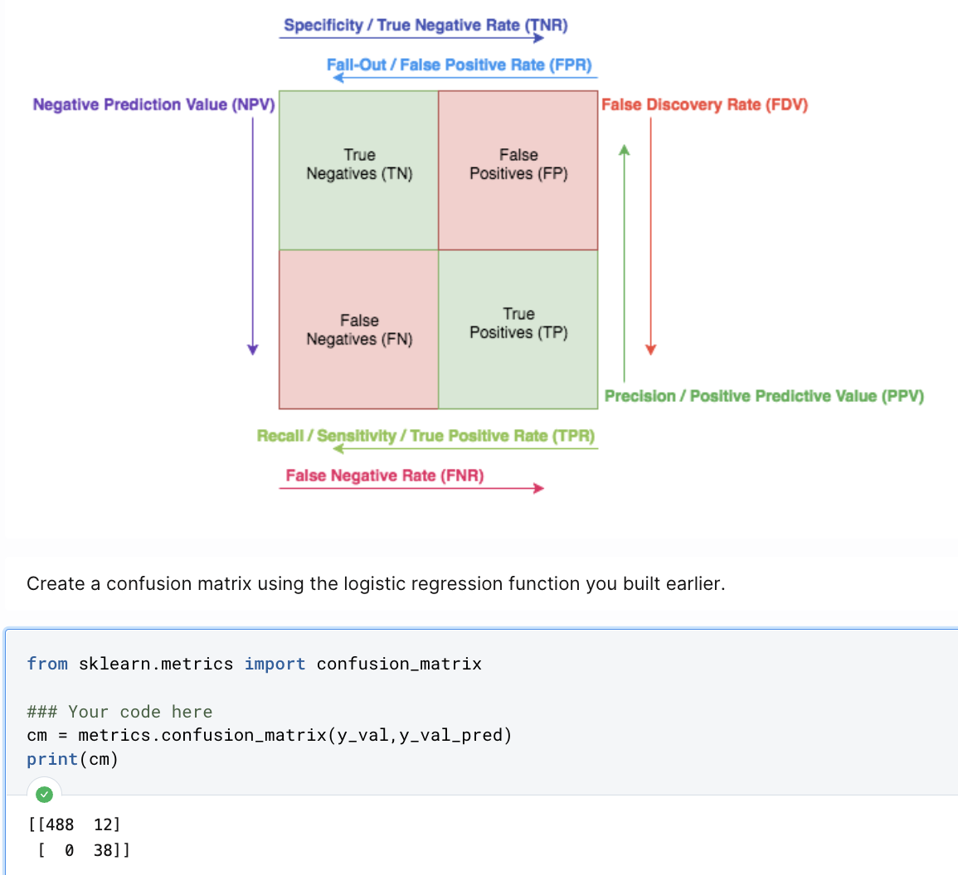
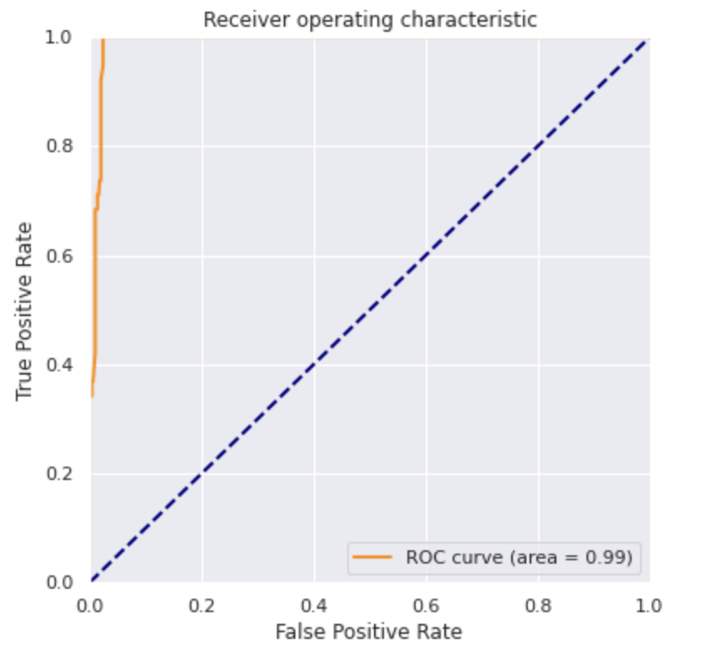
ROC curve + Confusion matrix

